Slide 1
Playoff Predictor
Lucas & Andrew

Slide 2
NFL Data
Team NFL game statistics from 2002 – 2024
Scraped from ESPN’s “hidden” API
5,256 observations x 61 columns
Goal: (Based on first half of the regular season)
Predict if a Team will make Playoffs
Predict if a Team in the playoffs will make the Conference Final

Slide 3
Pre - Processing
Feature Engineering
Games Won
Games Lost
Opponent Win Percentage
Made Playoffs
Split the data in half by # of weeks
Created summarized columns – averaged all numeric statistics for the first half of each season
Removed unnecessary columns

Slide 4
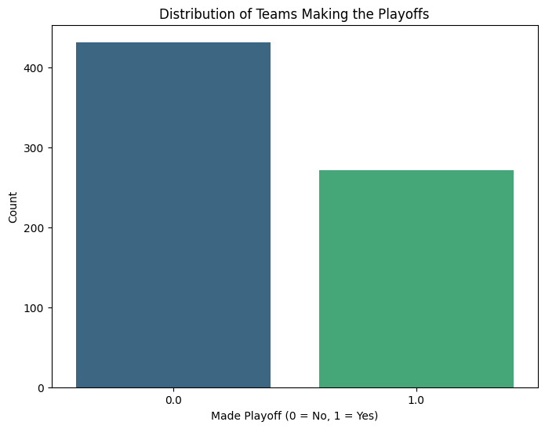
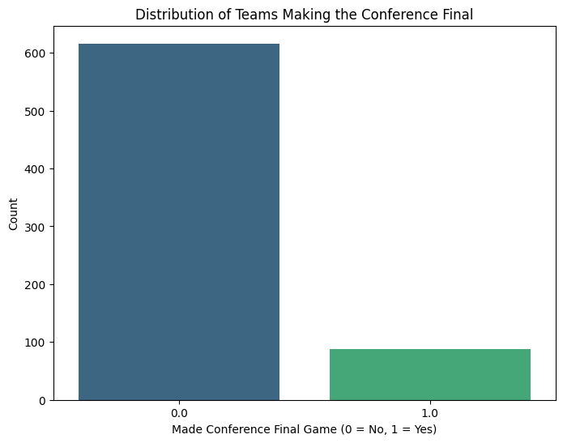
Distribution of Targets
Almost all variables have symmetrical distributions
None of the variables have visible outliers
0.39 Made Playoff
0.125 Made Conference Final

Slide 5
Methods
Random Forest Classifiers
Resistant to Overfitting
Handles High-Dimension Data
Can use to find Important Features
Principal Component Analysis
Used to reduce dimension
Retains specified variance
Recursive Feature Elimination
Remove least important features until desired number of features are left

Slide 6
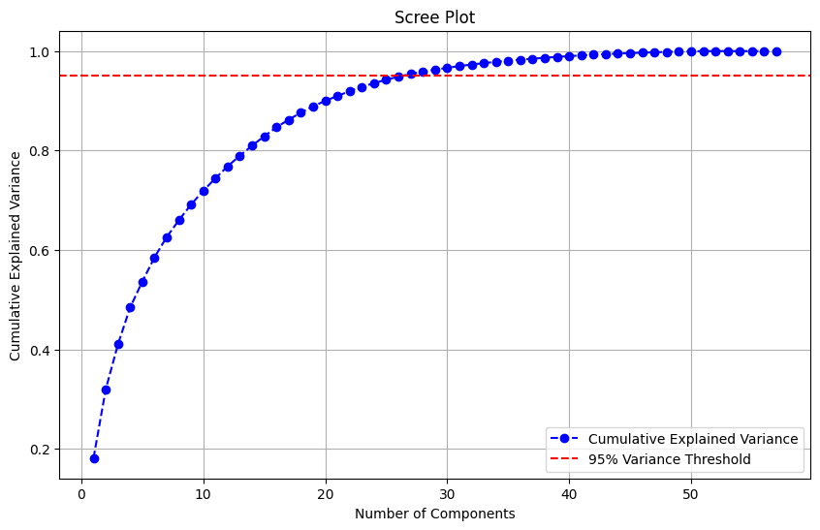
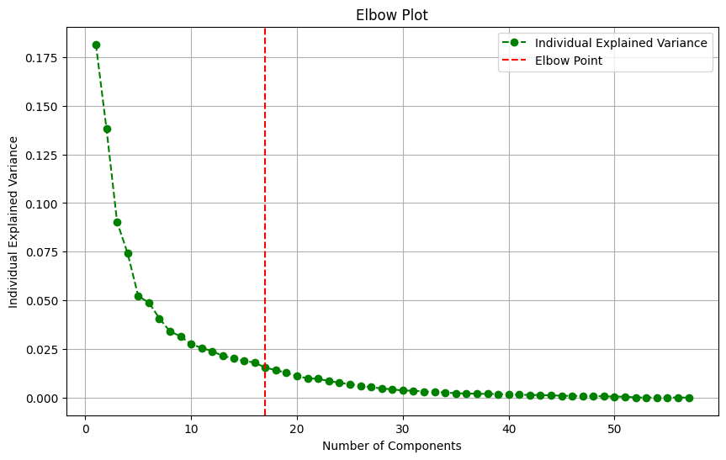
RF Classifiers With PCA
First RF Classifier (Predict Playoffs)
Standardize Variables
Apply PCA
Calculate Cumulative and Individual Explained variance
Select # of Components
Split data into Training and Testing
Apply RF
Accuracy of 0.773

Slide 7
RF Classifiers
First RF Classifier (Predict Playoffs)
Split data into training and testing sets
Recursive Feature Elimination (RFE)
Train optimal model
Test accuracy
Second RF Classifier (Predict Conference Final Appearance)
Select only training data from first classifier that are from playoff teams
RFE
Eventually test model with predicted values from the first model

Slide 8
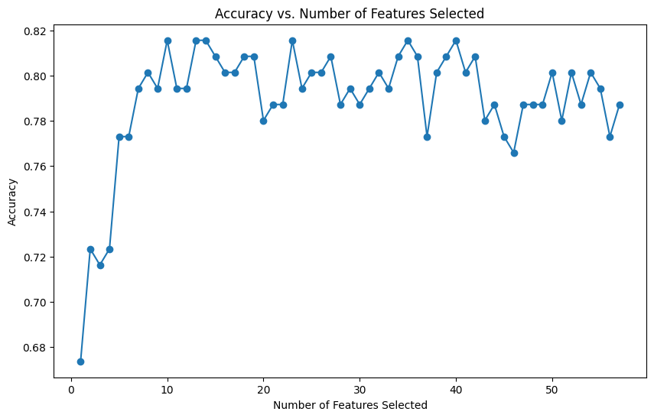
RFE of Playoff Classifier

Slide 9
Features Selected for RF 1
Selected Features:
Team Score
Team first downs
Team yards
Team sack yards
Opponent Score
Opponent Rush Attempts
Opponent Rush Yards
Opponent Penalty Yards
Games won
Games lost

Slide 10
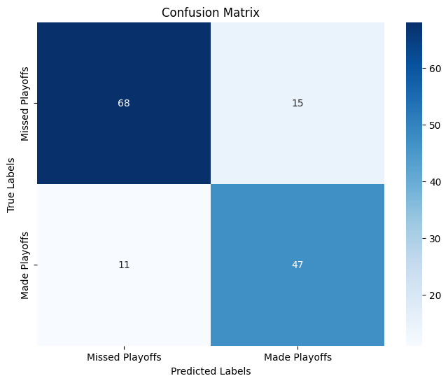
Results – RF to Predict Playoffs
Accuracy: 0.82
Precision:
Made playoffs: 0.76
Missed playoffs: 0.86
Recall:
Made Playoffs: 0.81
Missed Playoffs: 0.82

Slide 11
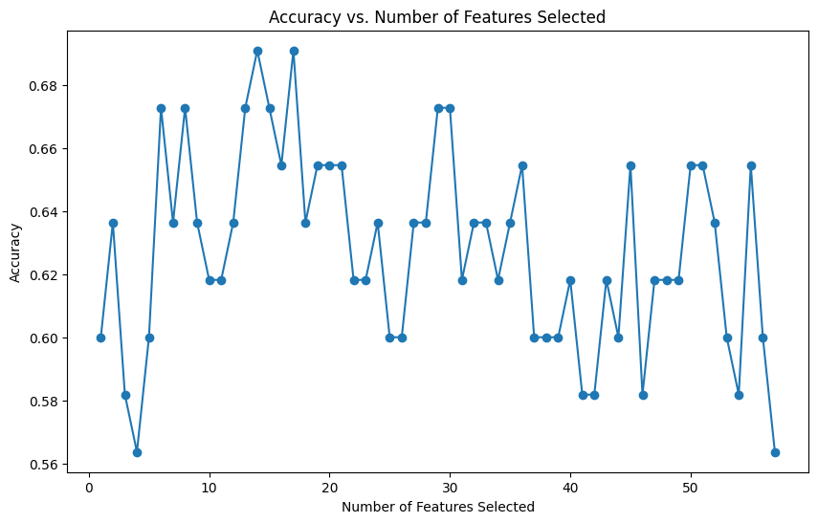
Predict Conference Final Participants
Select only Playoff teams data
RFE

Slide 12
Features Selected for RF 2
Selected Features:
Team Score
Team first downs
Team first downs from passing
Team third down attempts
Team number of plays
Team Rush Yards
Team Penalty Yards
Team Redzone Completion
Opponent Score
Opponent third down attempts
Opponent Sacks
Opponent rush yards
Opponent fumbles

Slide 13
Using RF Models Together
Used testing data for initial model
Take playoff predicted teams stats and use in second model
Results for Predicting a Team will make a Conference Final Appearance:
Overall Accuracy = 0.74
Precision
Made Conf. Final = 0.32
Missed Conf. Final = 0.93
Recall
Made Conf. Final = 0.67
Missed Conf. Final = 0.75

Slide 14
Predicting Playoffs Using a 5 Feature Model
Used 2024 Lions and Packers first half-season data to predict if they will make the playoffs
5 Features Used:
Team score (0.23)
Opponent Score (0.22)
Opponent Penalty Yards (0.21)
Games Won (0.17)
Games Lost (0.17)
Both Predicted to Make Playoffs

Slide 15

Conclusion
Predicted Playoffs with 82% Accuracy
RF model chaining – Predicted Conference Final Appearance with 74% Accuracy

